Slide 1
Recurrent Neural Networks
for Computer Vision
Understanding sequential learning in visual data — from video frames to image captioning

Slide 2
Contents
01
02
What is RNN?
Types of RNN
03
04
Introduction to LSTM
How LSTM Works?
05
06
RNN for Text Prediction
Key Takeaways

Slide 3
What is an RNN?
A Recurrent Neural Network (RNN) is a neural network specifically designed for sequence data.
Unlike standard networks, it maintains a hidden state — a form of memory — that carries information from previous time steps into the current computation.
Core Mechanism
The RNN Formula
At each time step, the network takes the current input xt and the previous hidden state h{t-1} to produce a new hidden state.
ht​=f(Wxt​+Uht−1​+b) Where W and U are weight matrices, b is bias, and f is the activation function.

Slide 4
RNN Architecture: Memory + Computation
A neural network that maintains a hidden state — carrying past information forward to influence each new output.
Three Core Layers
Parameter Sharing
1
Input Layer (x_t)
A defining feature of RNNs is that the same weights are reused across all time steps. This is called parameter sharing.
Receives the current input at each time step
2
Hidden Layer (h_t)
Stores and updates memory across time steps
Reduces the total number of parameters
Allows the model to generalize across sequence positions
Makes the network efficient for variable-length sequences
3
Output Layer (y_t)
Produces the prediction or result

Slide 5

RNN vs. Standard Neural Network
Standard Feedforward NN
Recurrent Neural Network
Processes a single, fixed-size input
No mechanism for temporal context
Each forward pass is stateless
Suitable for: image classification, tabular data
Processes sequences of arbitrary length
Hidden state persists across time steps
Shares parameters across the sequence
Suitable for: video, speech, text, tracking
The key architectural difference: RNNs have recurrent connections — edges that feed the hidden state back into itself at the next time step. Standard NNs have none.

Slide 6

Why Use RNNs in Computer Vision?
Many vision problems are inherently temporal — a single frame rarely tells the full story.
Video as Sequences
Motion & Dynamics
Cross-Frame Context
Videos are ordered stacks of frames. Understanding actions, events, or anomalies requires modeling how frames change over time.
Optical flow, gesture recognition, and activity detection all depend on temporal continuity — not just spatial features.
Objects occluded in one frame can be inferred from neighboring frames. RNNs maintain that contextual thread across the sequence.

Slide 7
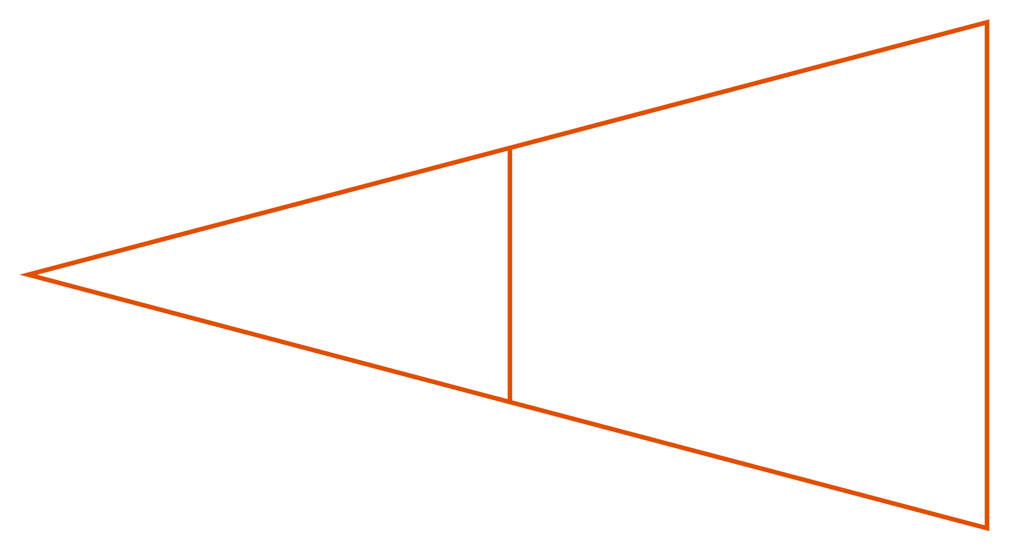
Video Classification
CNN → RNN Pipeline
A CNN (e.g., ResNet) acts as a per-frame feature extractor, producing a compact feature vector for each frame. The RNN ingests this sequence and learns which temporal patterns define each action class.
Frame CNN
Sequence RNN

Slide 8
Image Captioning
"A child is playing with a ball in the park."
Step 1 — Encode
This encoder-decoder architecture bridges vision and language. The CNN provides what is in the image; the RNN structures how to describe it grammatically and coherently — word by word.
CNN (e.g., VGG, Inception) encodes the image into a fixed-length feature vector
Step 2 — Initialize
Feature vector seeds the RNN hidden state as the starting context
Step 3 — Decode
RNN generates one word per time step until an end token is predicted

Slide 9
Object Tracking
In multi-frame tracking, the challenge is maintaining a consistent object identity even under occlusion, lighting change, or rapid motion.
How RNN Helps
Surveillance
Retail Analytics
The hidden state encodes the object's trajectory history — position, velocity, and appearance — enabling robust re-identification across frames.
Track individuals across camera feeds in real time. RNNs handle the temporal gap when a subject exits and re-enters the frame.
Count footfall, measure dwell time, and analyze customer movement patterns — all powered by sequential identity maintenance.

Slide 10
LIMITATIONS
Where RNNs Struggle
Vanishing Gradient Problem
Partial Solutions
Gradients shrink exponentially as they propagate back through many time steps. The network effectively forgets distant past information during training.
LSTM
Long Short-Term Memory adds gating mechanisms (input, forget, output) to selectively retain or discard information
Sequential Bottleneck
Steps must be processed one at a time — no parallelism across the sequence. This makes training on long video clips computationally expensive.
GRU
Gated Recurrent Unit — a lighter variant with fewer parameters, often competitive with LSTM

Slide 11
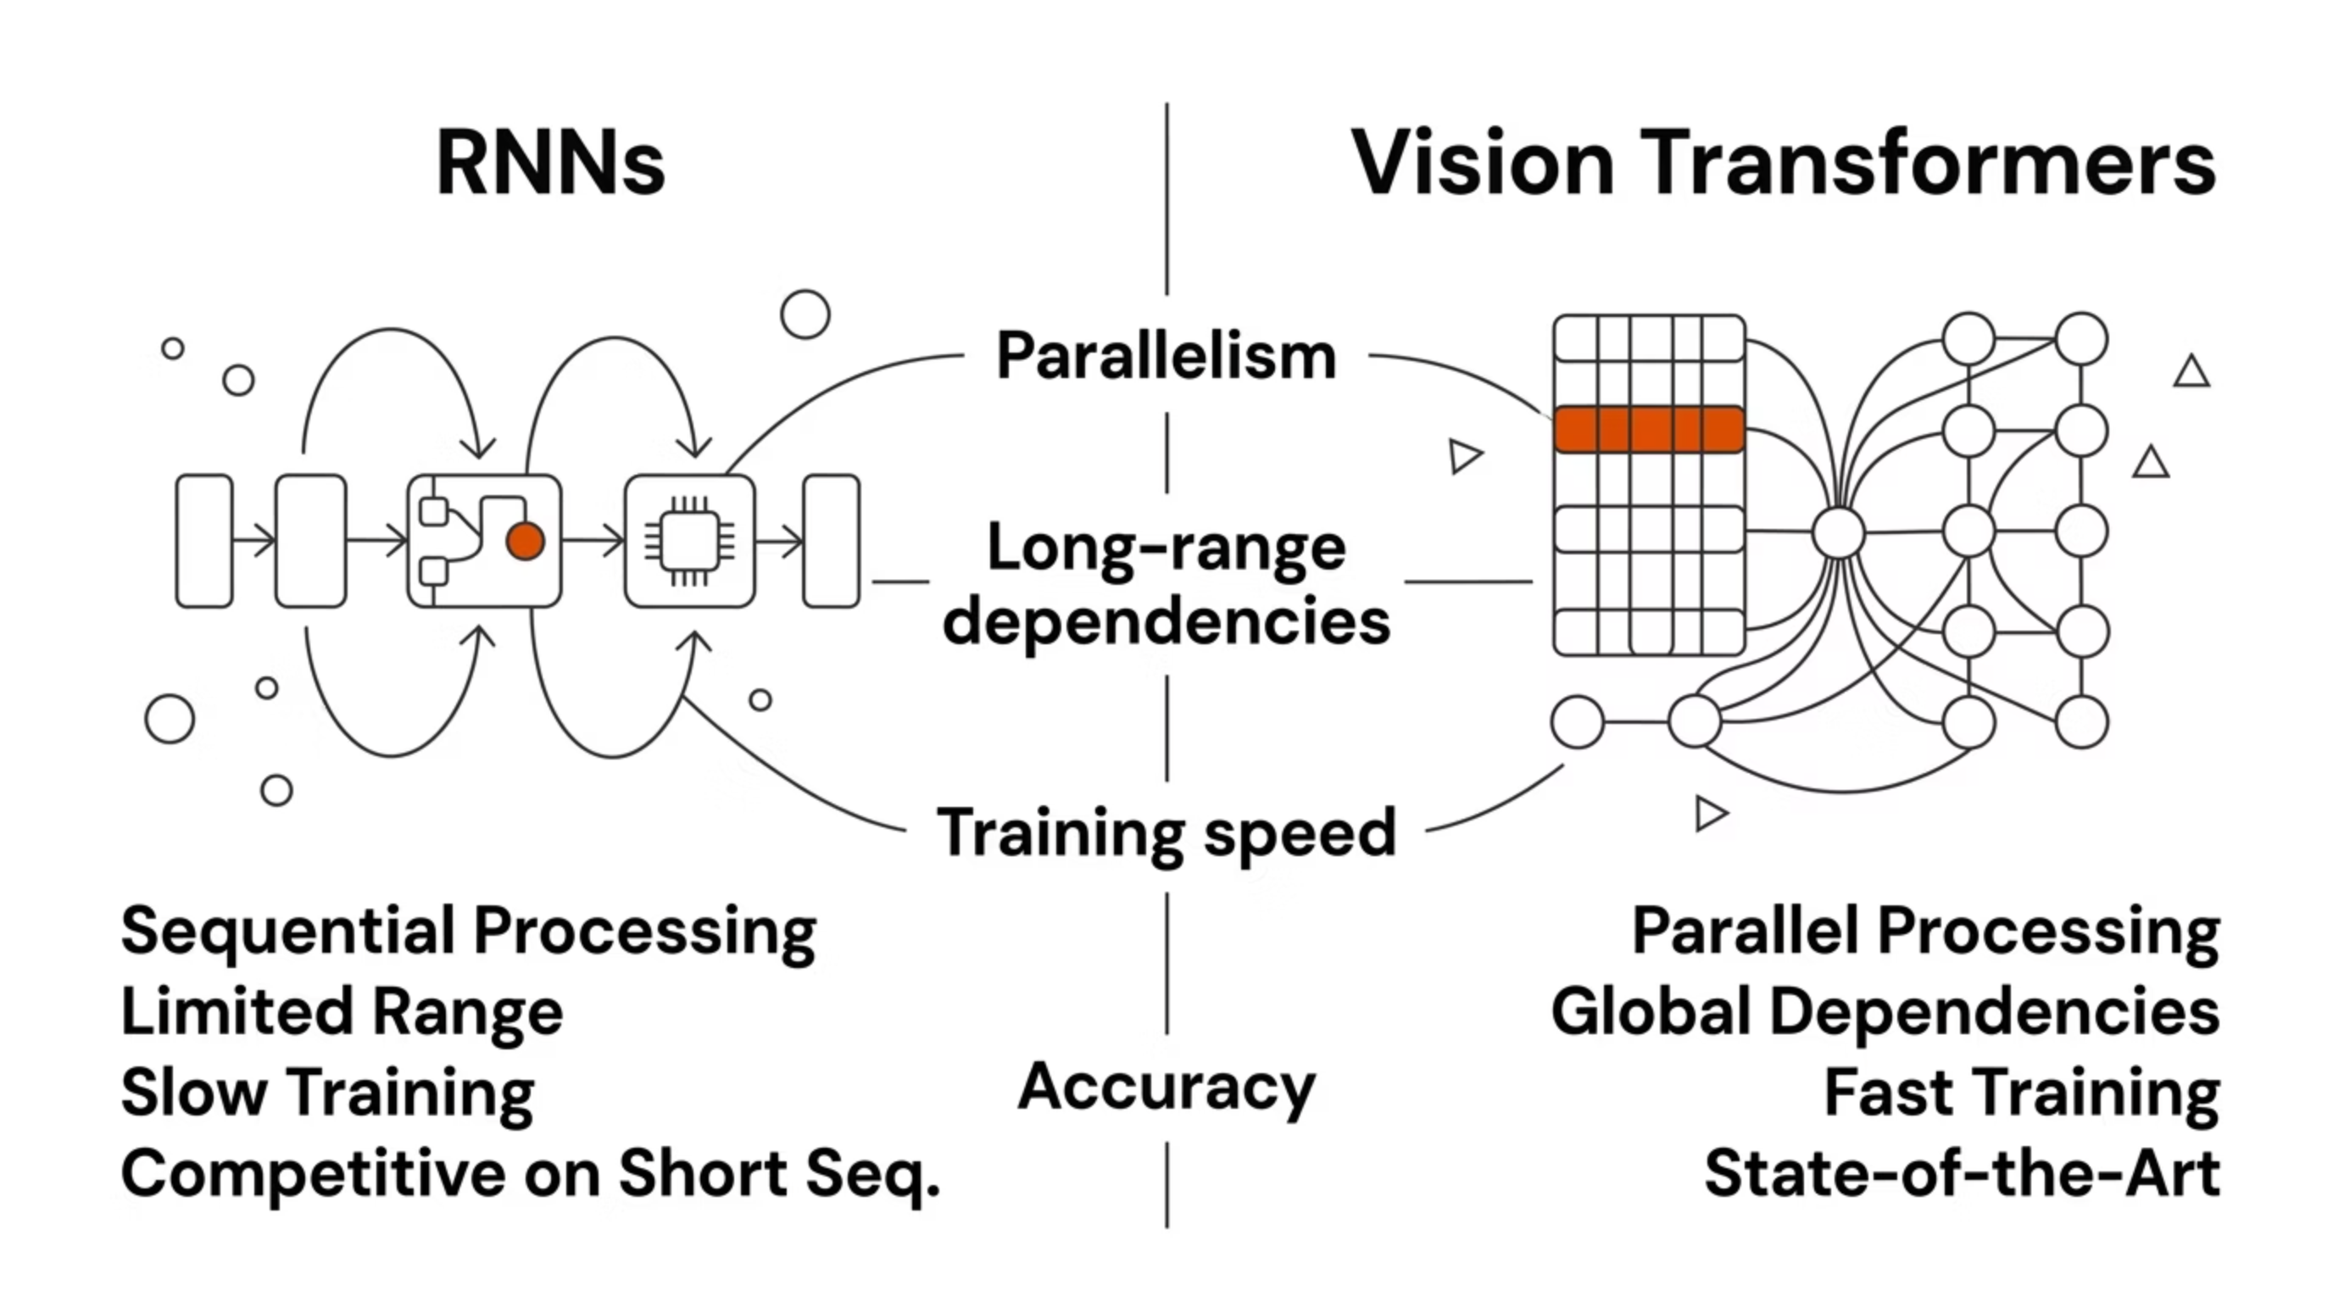

PARADIGM SHIFT
The Rise of Vision Transformers
Introduced by Dosovitskiy et al. (2020), Vision Transformers (ViT) patch images into tokens and apply self-attention globally — eliminating the sequential bottleneck. Video Transformers (TimeSformer, VideoMAE) extend this to spatio-temporal modeling.

Slide 12

RNNs in the Modern Landscape
~2014
~2020
CNN+RNN pipelines dominate video understanding and captioning (Vinyals et al., Karpathy et al.)
ViT demonstrates Transformers match or beat CNNs on image tasks at scale
1
2
3
4
~2017
Today
"Attention Is All You Need" — Transformers introduced, initially for NLP
RNNs remain relevant in edge/embedded contexts; Transformers lead on benchmarks
RNNs are not obsolete — they remain relevant in low-resource, real-time, or embedded settings where transformer overhead is prohibitive.

Slide 13
Key Takeaways
01
02
Memory is the Core Idea
Vision Is Inherently Sequential
RNNs introduce a hidden state that persists across time — the foundational concept behind all sequential deep learning
Video classification, captioning, and tracking all benefit from modeling temporal dependencies across frames
03
04
Limitations Drive Innovation
Transformers Are Now Dominant
Vanishing gradients → LSTM/GRU. Sequential bottleneck → Transformers. Each limitation motivated a major architectural advance
ViT and video transformers outperform RNN-based approaches on most benchmarks, but RNNs remain a critical conceptual foundation

